Slide 1
AP World History

Slide 2
Agenda
World War II
War in Europe

Slide 3
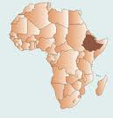
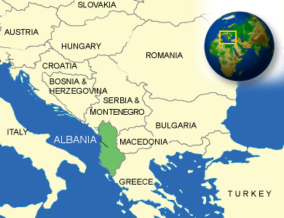
Path to WWII
Italy’s Conquests
Wanted more land
1935-1936 = invaded and conquered Ethiopia
1939 = invaded and conquered Albania

Slide 4
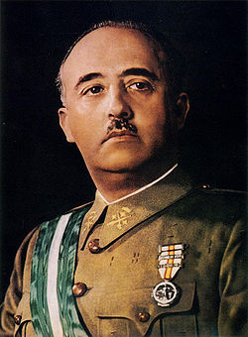
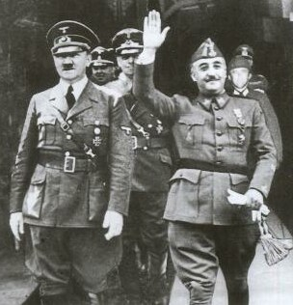
Path to WWII
Spanish Civil War
Between Communists and Fascists in Spain
Soviet Union backed the Communists
Mussolini and Hitler backed the Fascists
Sent supplies and troops to help the Fascists win
New fascist dictator in Spain = Francisco Franco

Slide 5
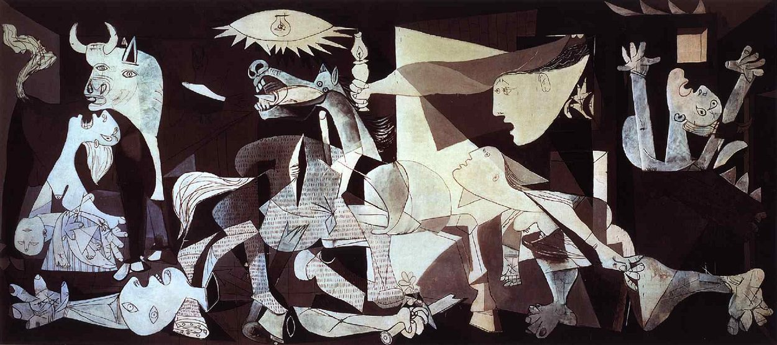
Guernica, 1937 by Pablo Picasso

Slide 6
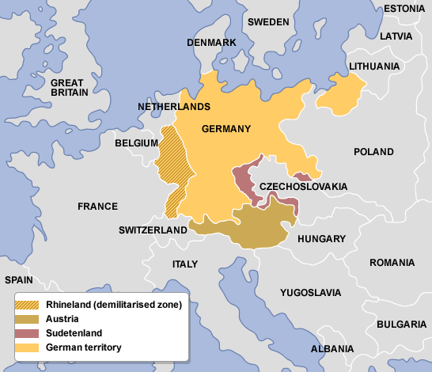
Hitler on the Offensive
March 1936 = Hitler sent troops into the Rhineland
Allies did nothing
October 1936 = Hitler & Mussolini signed the Rome-Berlin Axis = an alliance
Later joined by Japan = became the Axis Powers
No counter-alliance from the Allies
March 1938 = German “Anschluss” with Austria
Anschluss = means union
Hitler invaded Austria and united it with Germany
Allies did nothing

Slide 7
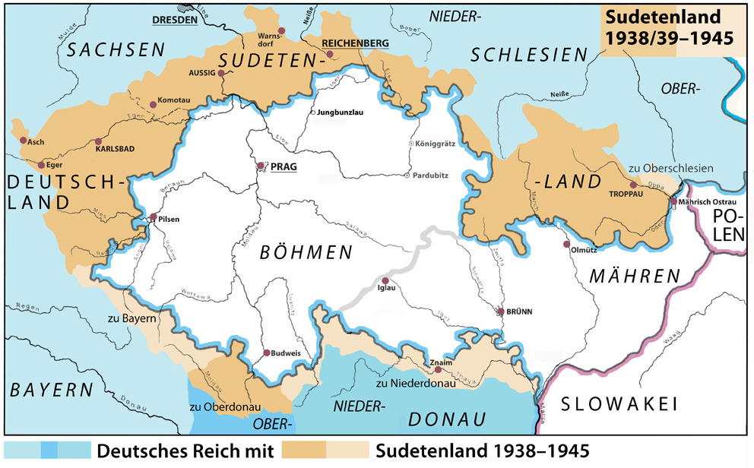
Hitler on the Offensive
September 1938 = Hitler demanded that Germans in the Sudetenland join Germany
3 million Germans there
Sudetenland = in northwestern region of Czechoslovakia
Czechoslovakian leaders declare martial law

Slide 8
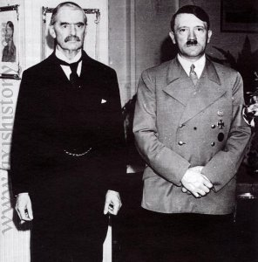
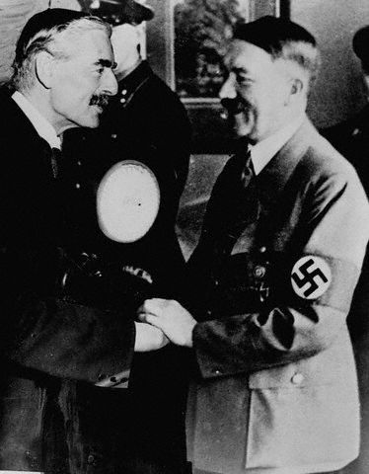
Hitler on the Offensive
September 15, 1938 = Neville Chamberlain (leader of England) and Hitler meet
Hitler wants the Sudetenland to join Germany
Chamberlain goes with policy of appeasement = granting concessions to maintain peace

Slide 9
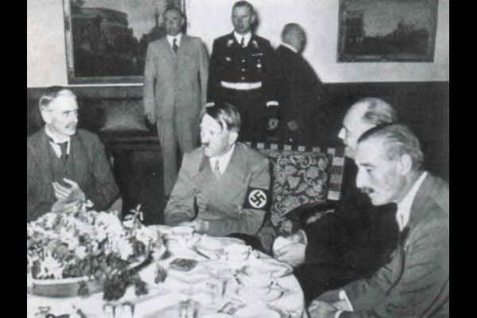
Munich Conference
September 29, 1938 = Chamberlain, Hitler, Mussolini, and Daladier (from France) meet
Hitler says if he can have the Sudetenland then he won’t touch the rest of Czechoslovakia or take any other European territories
Great Britain and France agree to this

Slide 10
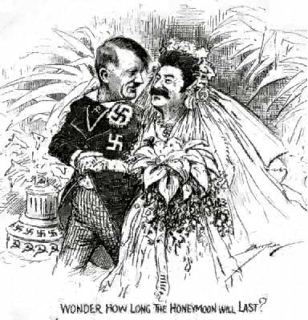
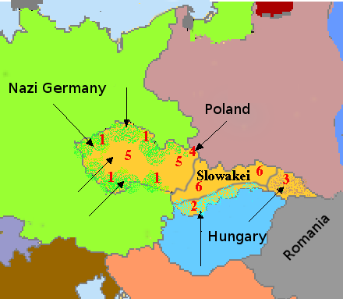
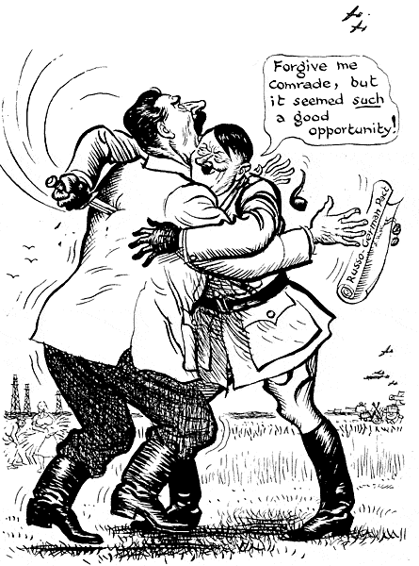
Hitler on the Offensive
March 1939 = Hitler sent troops into Czechoslovakia and took it over
August 1939 = Hitler and Stalin signed the Nazi-Soviet Nonaggression Pact
They agreed to not invade each other
They agreed to stay neutral if the other went to war
Both sides knew that this pact wouldn’t last long

Slide 11
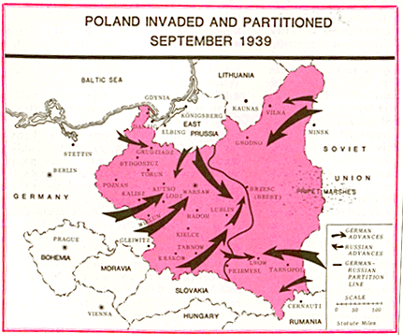
Hitler on the Offensive
Now Hitler didn’t have to worry about Soviets attacking from the east
September 1, 1939 = Hitler invaded Poland
2 days later = Poland, Great Britain, and France declared war on Germany
WWII had begun

Slide 12
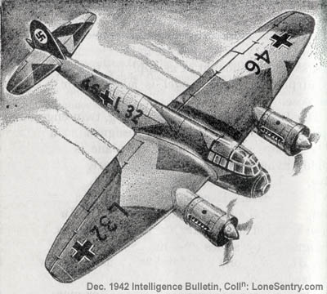


Attack on Poland
Germans used military tactic called blitzkrieg = “lightning war” = aimed at taking the enemy by surprise
Luftwaffe = German air force: swept in dropping bombs
Panzers = armored tanks: crossed the Polish border
Infantry = more than 1.5 million men poured in
Quick and efficient – Poland fell in a few weeks

Slide 13
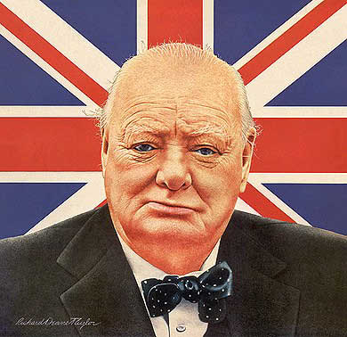
Hitler on the Offensive
April 1940 = Hitler invaded and conquered Denmark and Norway
England failed to stop these invasions
Neville Chamberlain stepped down as Prime Minister
Winston Churchill becomes new Prime Minister

Slide 14
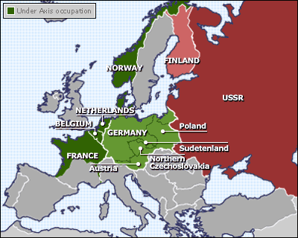
Hitler on the Offensive
May 1940 = Hitler conquered and invaded Luxembourg, the Netherlands, and Belgium

Slide 15
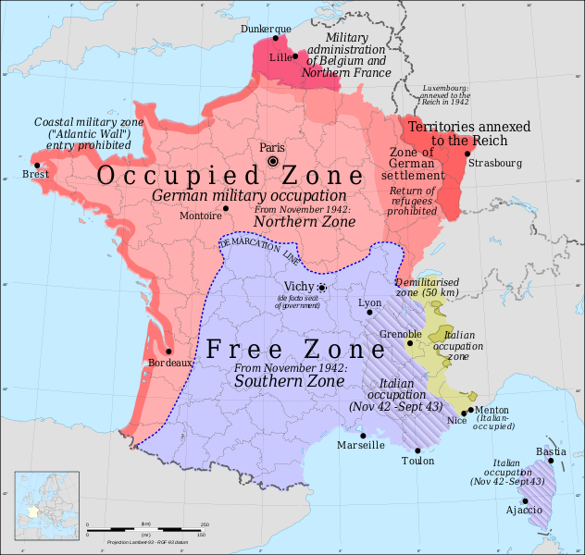
Fall of France
June 1940 = Hitler invaded France
June 14, 1940 = entered Paris
1 week later = France surrendered to Germany
Germans controlled northern France
In southern France = Nazis set up a “puppet government” in Vichy, France
Run by French officials, but they collaborated with the Germans

Slide 16
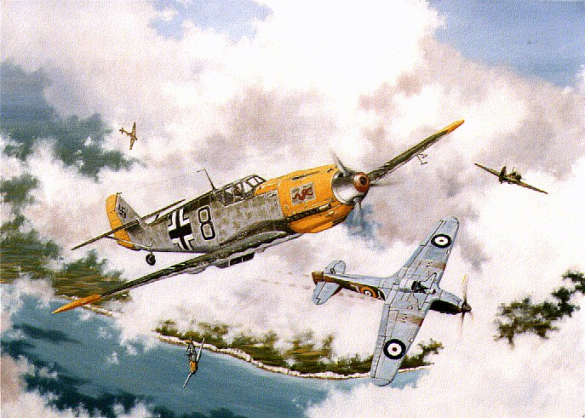
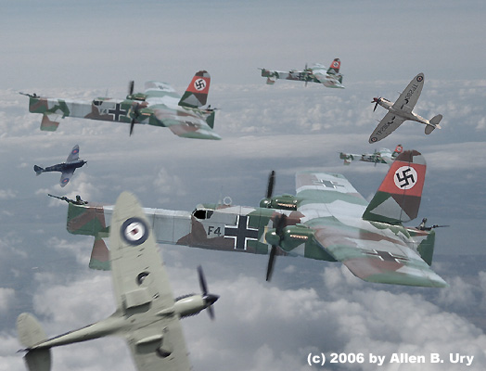
Battle of Britain
Hitler’s next target = Great Britain
Hitler thought he’d take over Britain by winning “air supremacy” and destroying Britain’s Royal Air Force
August 1940 = Luftwaffe began bombing Great Britain
Destroyed 4 aircraft factories and 5 RAF fields
75 German planes shot down in the process

Slide 17
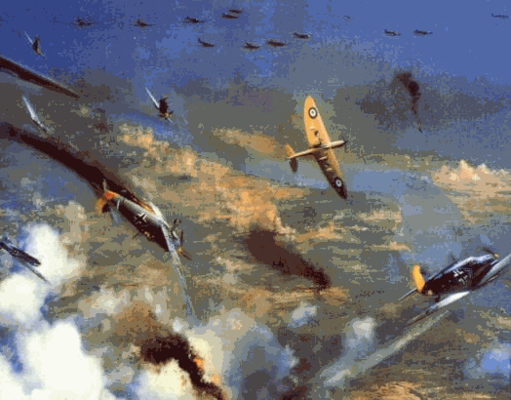
Battle of Britain
August 24 - September 6, 1940 = Nazis sent over 1,000 planes a day
RAF lost 466 planes & 103 pilots
Even heavier losses for the Germans
September 7 - November 3, 1940 = German bombers hit London with a blitz = series of air raids
In 1 night alone = 70,000 bombs fell on London

Slide 18
Battle of Britain
Great Britain never backed down
Hitler never gained “air supremacy”
More than 1700 Nazi aircrafts shot down in the Battle of Britain
Hitler’s invasion was blocked

Slide 19
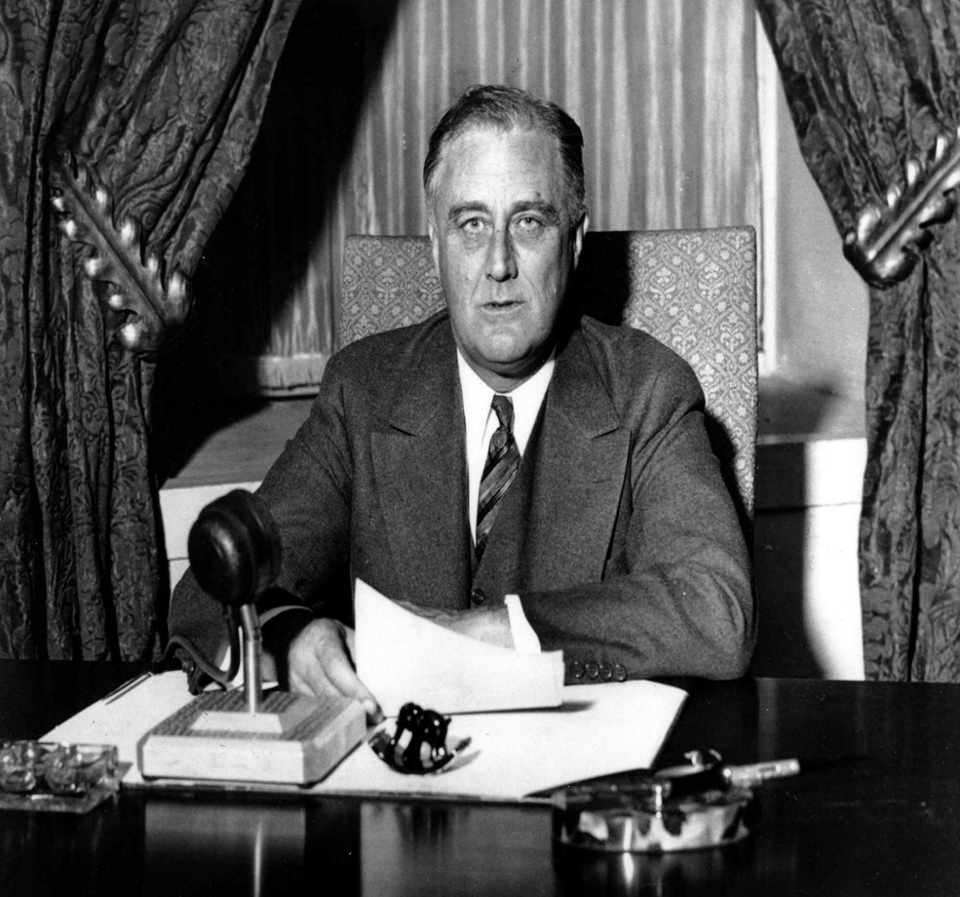
Cooperation from the U.S.
U.S. wanted to remain neutral
Neutrality Acts (1937) = banned arms, shipments, loans, and credit to warring nations
As Hitler got more aggressive, U.S. President Franklin D. Roosevelt felt the need to aid the Allies
Cash-and-Carry Policy = Great Britain could trade cash for supplies from the U.S.

Slide 20
Cooperation from the U.S.
Cost of WWII started to drain Britain’s treasury --> couldn’t pay cash anymore
U.S. approved “lend-lease policy”= President could lend war equipment to any country whose defense was vital to the U.S.

Slide 21
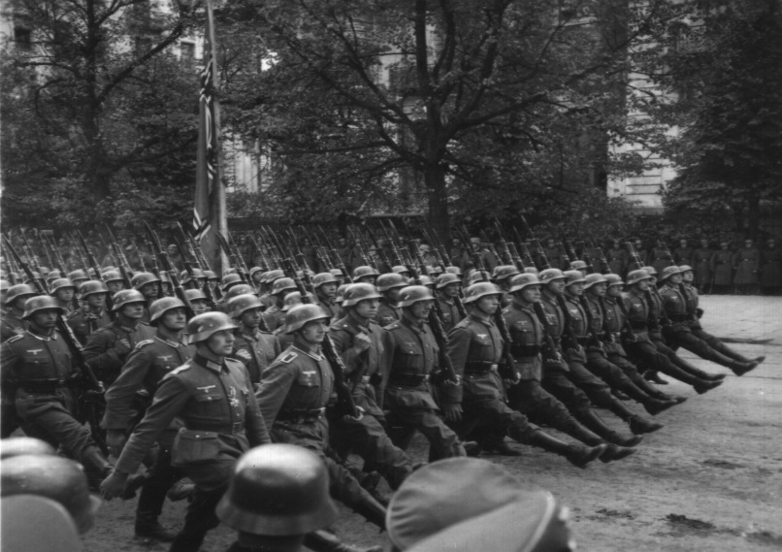
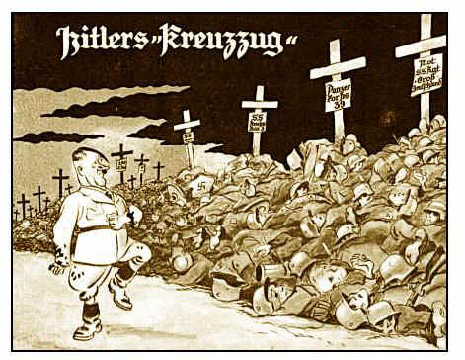
Invasion of the Soviet Union
Having failed in Great Britain = Hitler turned his sights on the Soviet Union
June 22, 1941 = Hitler broke the Non-Aggression Pact and invaded the Soviet Union
Within a few days = Nazis destroyed most of the Soviet air force, disabled thousands of their tanks, and captured 1/2 a million Soviet soldiers

Slide 22
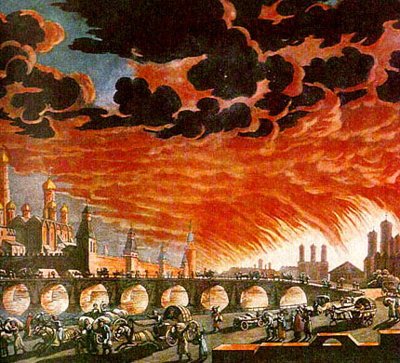
Invasion of the Soviet Union
Stalin issued his scorched-earth policy = if Soviets had to retreat, they would destroy/burn everything that could be of use to the invaders
Germans ended up getting as far as Moscow = about 600 miles into the Soviet Union
December 1941 = Soviets able to launch a successful counterattack to save Moscow and force the Nazis to retreat from the city

Slide 23
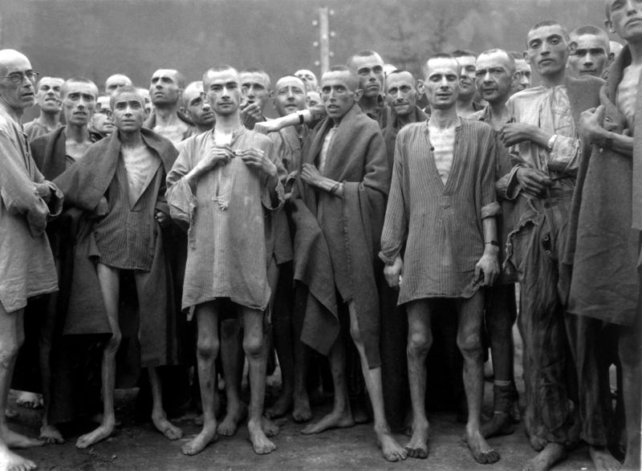
The Holocaust
Hitler’s goal = complete extermination of all Jews in Europe
1941 - 1944 = the Holocaust = more than 6 million Jews were mass murdered
Another 6 million non-Jews were also killed = gypsies, Slavic people, mentally and physically disabled, homosexuals, political opponents, etc.

Slide 24
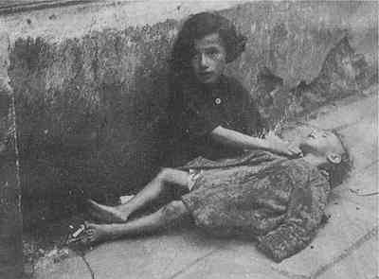
The Holocaust
Before being sent to concentration camps, many Jews were placed in ghettoes
Largest ghetto = in Warsaw, Poland
Unsanitary housing
Contagious diseases
No food
Tens of thousands died in the ghettoes

Slide 25
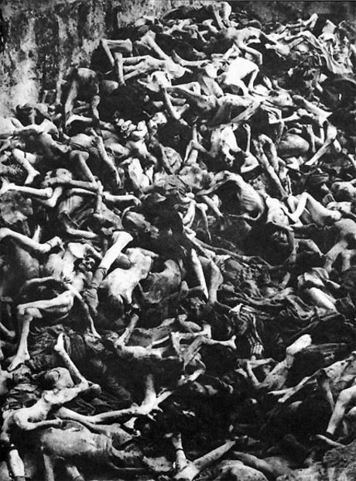
The Holocaust
Killing squads used to murder many Jews in the Soviet Union
SS soldiers took their valuables, marched them to the outskirts of town, and shot them
Bodies were dumped in mass graves
Killing squads killed more than 1 million Jews this way

Slide 26
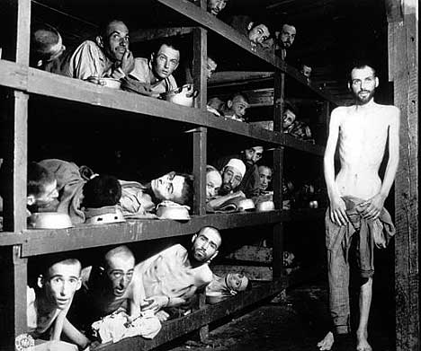
The Holocaust
“The Final Solution” = Nazi code term for the extermination of all European Jews
Genocide = the carefully planned killing of an entire group of people based on their race or culture
Nazis began rounding up hundreds of thousands of Jews and shipping them on trains or trucks to concentration camps and death camps

Slide 27
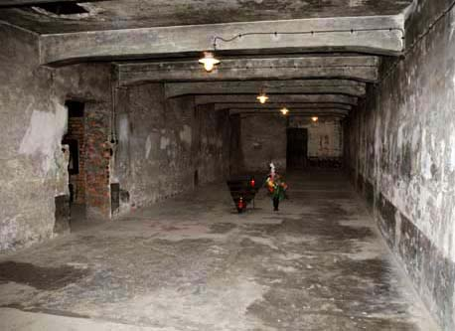
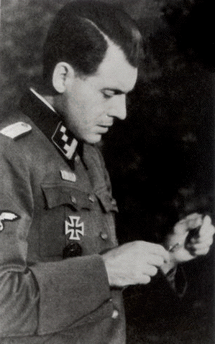
The Holocaust
Largest death camp = Auschwitz in Poland
Many people in the death camps were killed by the gas chambers
Others died of starvation and exhaustion
Others were the victims of cruel experiments done by Nazi doctors
Josef Mengele “The Angel of Death”

Slide 28
Turning Points in WWII
Battle of Stalingrad in the Soviet Union
Allies reclaim North Africa
Allies reclaim Italy
D-Day

Slide 29
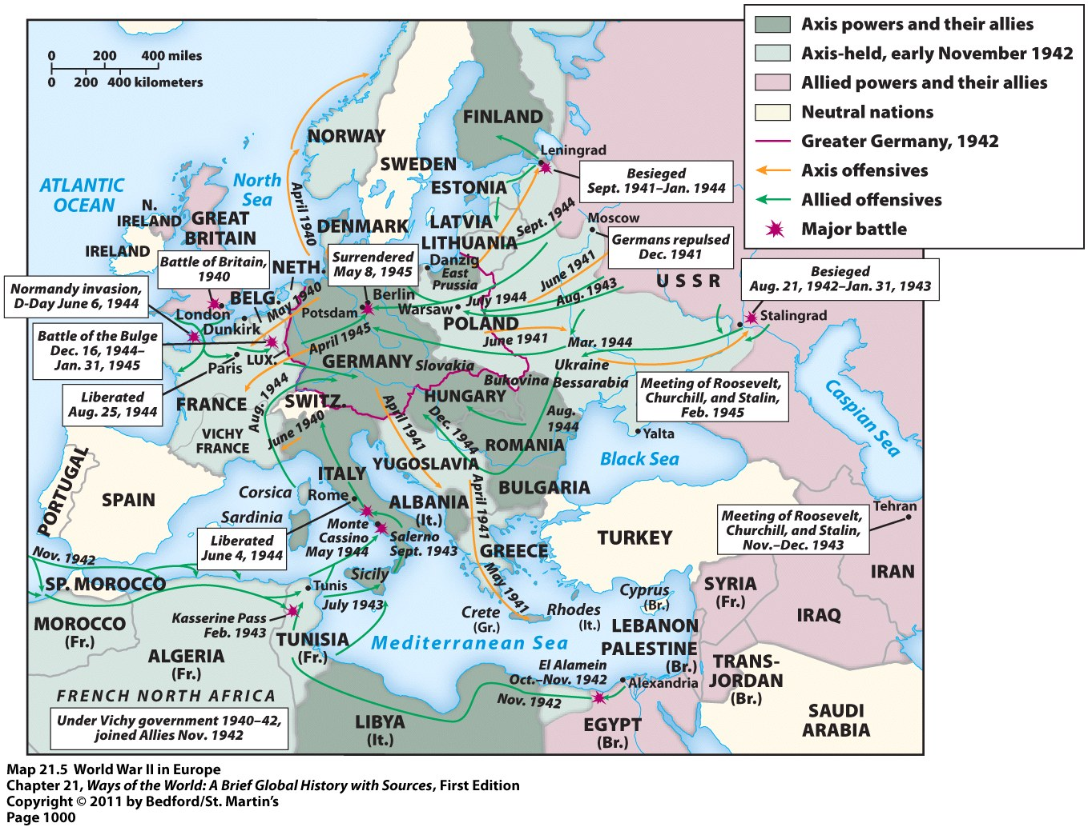

Slide 30
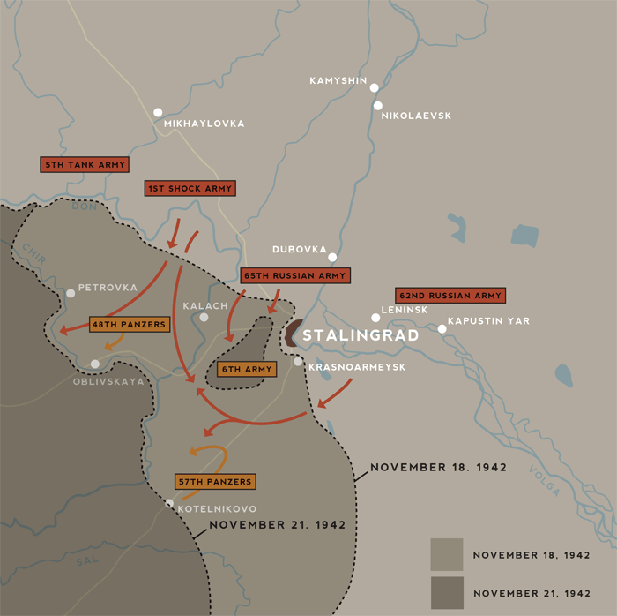
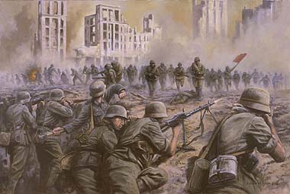
The Battle of Stalingrad
August 1942 = Germans attacked the major Soviet city of Stalingrad = a major industrial center
The Soviets mustered together everything they had and launched a massive counterattack
Encircled the German troops and cut off their supply lines
Hitler refused to allow his troops to retreat, even though the Soviet troops and harsh winter were closing in on them

Slide 31
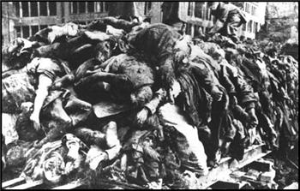
The Battle of Stalingrad
February 1943 = German officers surrendered
100,000 German soldiers killed
80,000 Germans = POWs
Large quantities of German military equipment seized
The Soviets began to slowly but surely continue westward towards Germany
Germany’s entire 6th Army lost

Slide 32
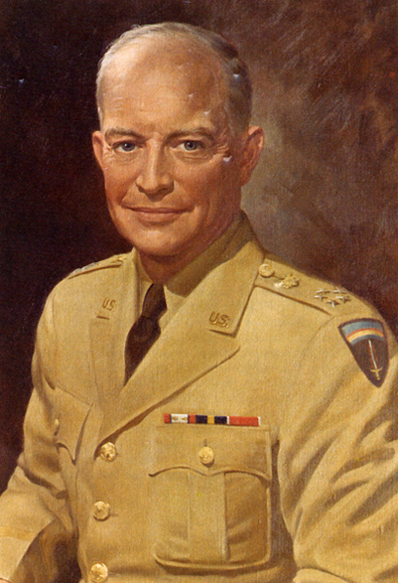
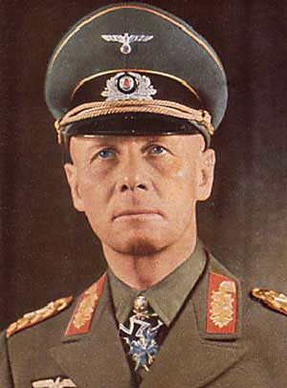
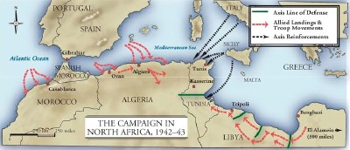
War in the Desert: The Reclaiming of North Africa
Early 1942 = Allied forces (under Commander Dwight D. Eisenhower) were struggling in North Africa
Up against a very good commander for the Axis Powers = German Commander Erwin Rommel
May 1942 = Battle at El Alamein = British able to stop the Germans’ advances into Egypt
October 1942 = Germans forced back across the Egyptian-Libyan border
January 1943 = British troops had regained Libya

Slide 33
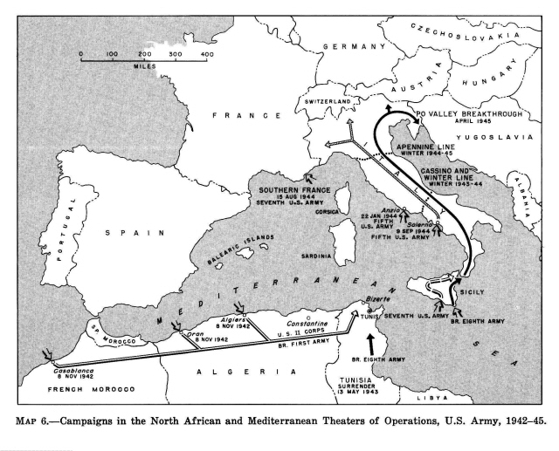
War in the Desert: The Reclaiming of North Africa
As British troops advanced westward, Allies landed more troops in Morocco and Algeria
Goal = to “squeeze out” the Germans in the middle
May 1943 = the Germans surrendered
Allies now controlled all of North Africa

Slide 34
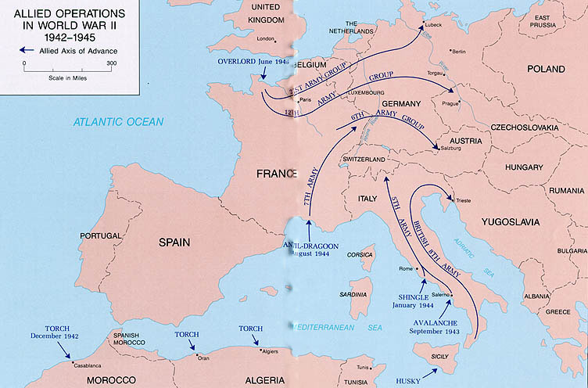
Reclaiming Italy
July 1943 = Allies attack island of Sicily
Conquered it in 6 days → then continued to mainland Italy
King Victory Emmanuel III fired Mussolini
New Prime Minister of Italy signed a secret act of surrender to the Allies
But: there are still German troops in Italy and they aren’t giving up
Allies continue north through Italy
June 4, 1944 = Allied forces entered Rome and Germany surrendered

Slide 35
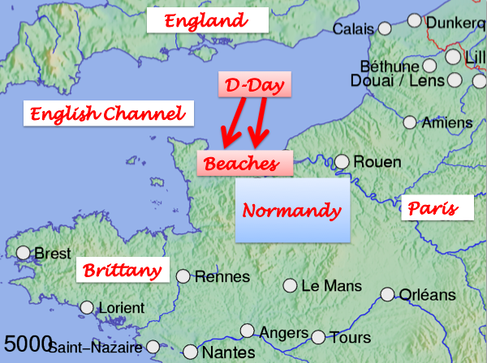
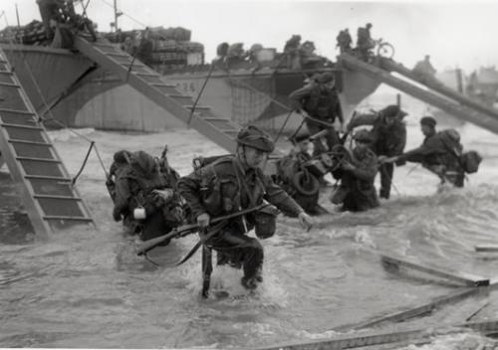
D-Day
Operation Overlord = Allied code name for the invasion of France
June 6, 1944 = D-Day = the day of the attack
Allied troops landed on the beaches of Normandy and fought their way forward amid German machine-gun fire
Heavy German resistance → but it was a success
August 25, 1944 = Allied troops had regained Paris

Slide 36
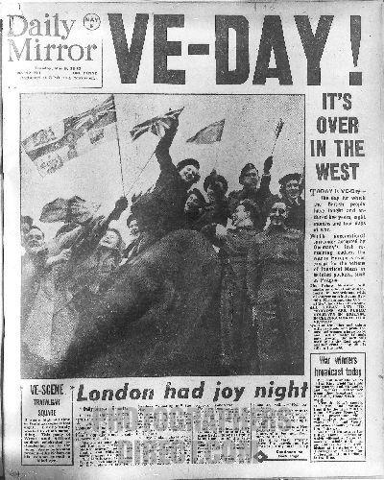
The Battle of the Bulge: Germany’s Last Stand
December 1944 → Germans cut through the center of American forces, creating a “bulge” in the Allied line of troops
March 1945 = advances of German troops were stopped
Meanwhile → Soviet troops are starting to invade Germany from the east
May 7, 1945 = Germany surrenders
May 8, 1945 = V-E Day = Victory in Europe Day

Slide 37
The Fate of the Fascists: Benito Mussolini
April 27, 1945 = he and his mistress were caught trying to escape Italy
The next day = both were executed (shot)
Their bodies were brought to Milan and dumped in a piazza there
After being shot, spat, and kicked upon – the bodies were hung upside down on meat hooks from the roof of a gas station
Civilians continued to stone the bodies from below

Slide 38
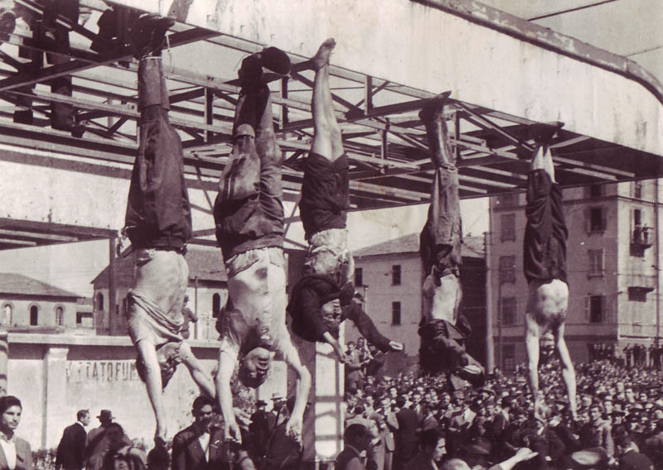
The dead bodies of Mussolini (2nd from left) and his mistress (in the middle). The others are also the bodies of executed Fascists.

Slide 39
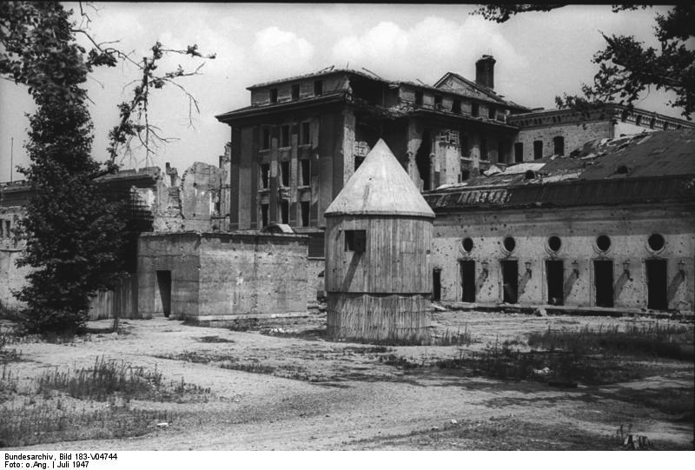
The Fate of the Fascists: Adolf Hitler
April 30, 1945 = Hitler and his wife, Eva Braun, committed suicide in the study of his “Führerbunker” in Berlin
Hitler = by gunshot
Eva = by cyanide poisoning
Per earlier instructions, their bodies were brought out to the garden, doused with gasoline, and burned
1947 photograph of the rear entrance of Hitler’s bunker

Slide 40
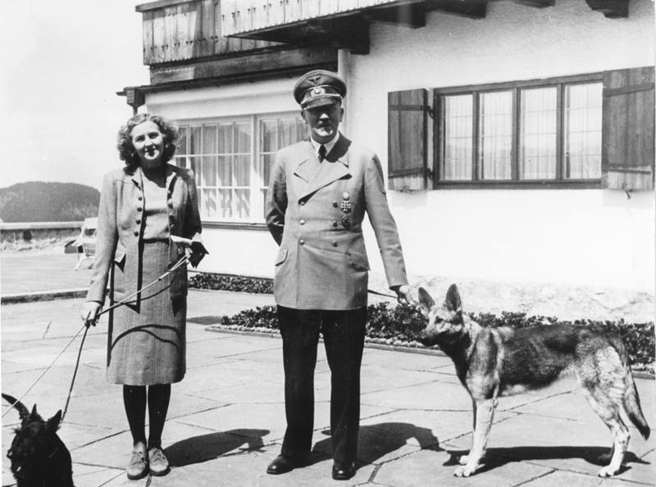

Slide 41
Effects of World War II
More than 70 million people fought in WWII
About 55 million died because of the war
About 40% = Soviet troops = country that lost the most lives in WWII
Millions more died in campaigns of genocide in Europe and Asia
As many as 12 million people left homeless
Many areas of Europe and Asia = completely destroyed and devastated

Slide 42
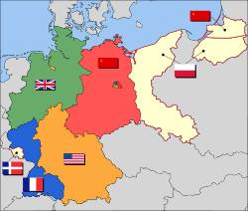
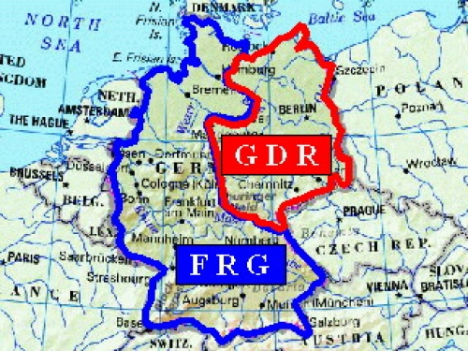
The Division of Germany
February 1945 = Yalta Conference
Germany, as well as the city of Berlin = divided into 4 zones
Controlled by Great Britain, France, the United States, and the Soviet Union
By 1949 = uniform administration emerged in the western zones and Germany split into two halves
Western half = democratic = Federal Republic of Germany
Eastern half = communist = German Democratic Republic

Slide 43
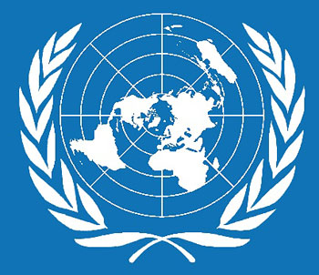
The United Nations
Created in 1945
International organization aimed at resolving disputes and maintaining peace after war
Most powerful nations = the United States, Great Britain, France, Russia, and China
All hold the 5 permanent seats on the UN Security Council – all have veto power
Also created in 1945 = the World Bank and the International Monetary Fund
Designed to regulate the global economy and prevent another world-wide depression

Slide 44
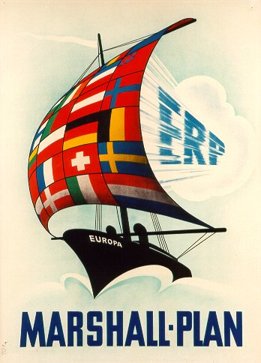
The Marshall Plan
Designed to rebuild shattered European economies
About $12 billion funneled into Europe from the United States
Why?
Genuine humanitarian concern
Desire to prevent another world-wide depression
Wanted overseas customers for American products
Wanted to undermine the appeal of communism in Europe
Very successful → European economies grew rapidly between 1948 and the 1970s

Slide 45

NATO
Created in 1949 – North Atlantic Treaty Organization
Military and political alliance led by the United States
Created because of the communist threat, as well as the possibility of future German aggression

